Slide 1




WINE CLASSIFICATION
By Jedy Sean Syah
DSF 36.0 - Data Science

Slide 2
BACKGROUND
This dataset is a collection of data used to classify grape types based on chemical analysis results. The data comes from three Italian grape cultivars grown in the same region of Italy. The purpose of this dataset is to classify grape samples into one of three cultivar classes based on 13 chemical attributes that can be used to confirm the authenticity of a wine and detect counterfeiting in the beverage industry.
DSF 36.0 - Data Science

Slide 3
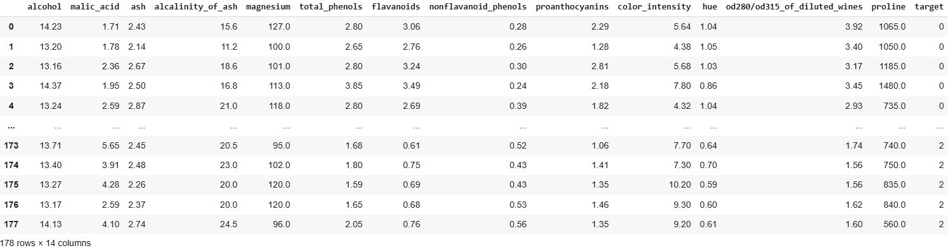
DATASET
The dataset is taken from the Scikit Learn library with a total of 178 samples, 13 columns, and 1 target column. The machine learning model to be used is K Nearest Neighbors.
DSF 36.0 - Data Science

Slide 4
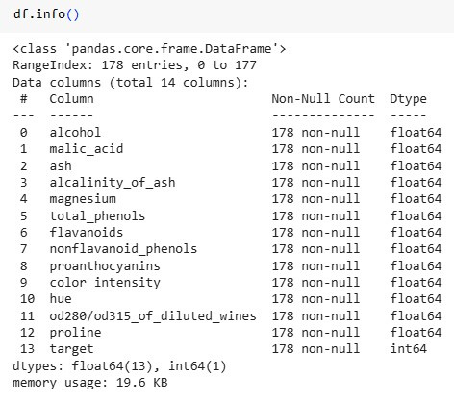
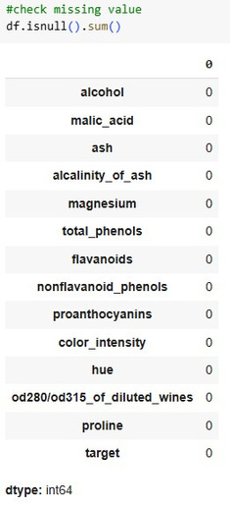
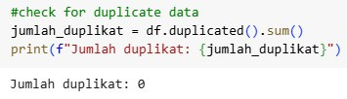
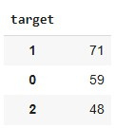
EXPLORATORY DATA ANALYSIS (EDA)
Data Type
Missing Value
Duplicate Data
Class Distribution
The data totaled 178 entries and there were no missing values or duplicate data. The distribution of each class is 59, 71, and 48. The difference in distribution is not too significant so the accuracy can be used for assessment.
DSF 36.0 - Data Science

Slide 5
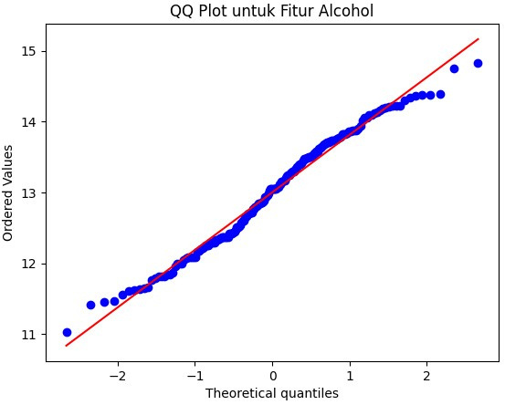
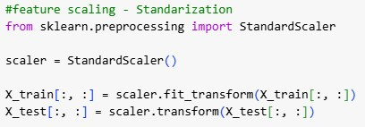
EXPLORATORY DATA ANALYSIS (EDA)
Data is normally distributed
Feature scaling with the standardization method
Standardization is used because the dataset distribution has a normal distribution.
Datasets in column X (feature) have different scales, this can affect the distance-based K Nearest Neighbors model. To avoid this, scaling is needed to equalize the scale.
DSF 36.0 - Data Science

Slide 6
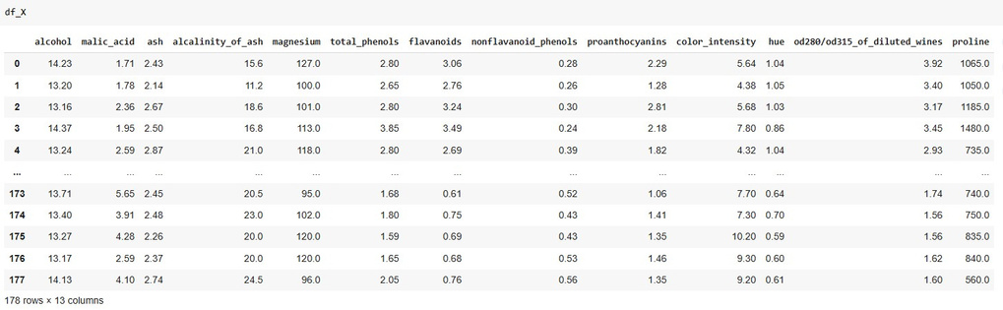
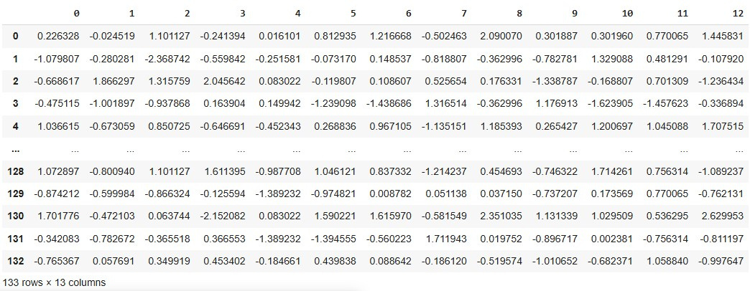
EXPLORATORY DATA ANALYSIS (EDA)
Before Standarization
The scaling-standardization method makes the features have a mean value = 0 and standard deviation = 1, making it more balanced for models that use distance calculations such as K Nearest Neighbors.
After Standarization
DSF 36.0 - Data Science

Slide 7

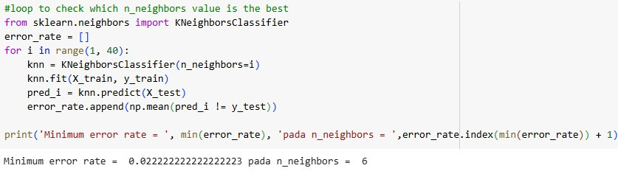
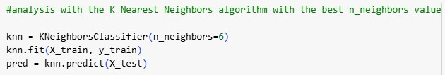
MACHINE LEARNING MODEL
Split Data:
The data is split into 75% train for the training model and 25% test for the test model.
Looping:
Looping to find the best n_neighbors value (with the minimum error rate).
Prediction:
prediction using the best n_neighbors parameter which is n_neighbors = 6.
DSF 36.0 - Data Science

Slide 8
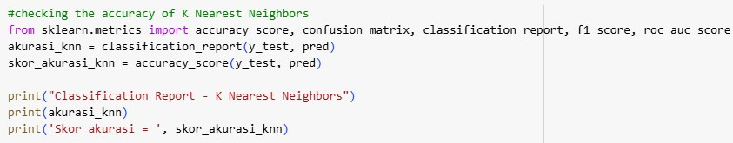
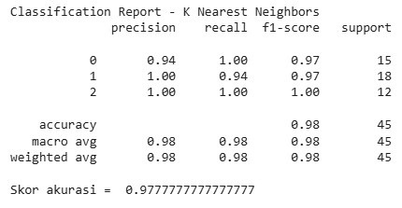
MACHINE LEARNING MODEL
EVALUATION
Classification Report
Precision to show how many correct positive predictions out of all predicted positives
Recall to show how many true positives out of all true positives
F1-Score to show the average of the precision and recall values.
Interpretation of Results
Class 0 → Precision 0.94, Recall 1.00 (all class 0 detected, few false positives).
Class 1 → Precision 1.00, Recall 0.94 (no false positives, but some false negatives).
Class 2 → Precision & Recall 1.00 (all class 2s are perfectly detected).
Overall accuracy = 97.77% (the model performed very well).
DSF 36.0 - Data Science

Slide 9
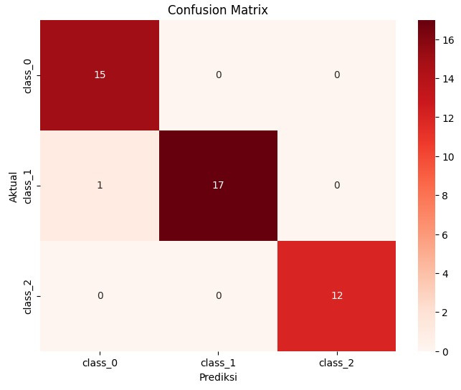
VISUALISASI
Correct Prediction:
Class 0 → 15 correctly classified as class_0
Class 1 → 17 correctly classified as class_1
Class 2 → 12 correctly classified as class_2
Incorrect Prediction:
1 data from class_1 is incorrectly classified as class_0.
Conclusion:
The model only experienced 1 prediction error, namely 1 data class_1 was incorrectly classified as class_0. So it can be said that this model is very good.
DSF 36.0 - Data Science

Slide 10
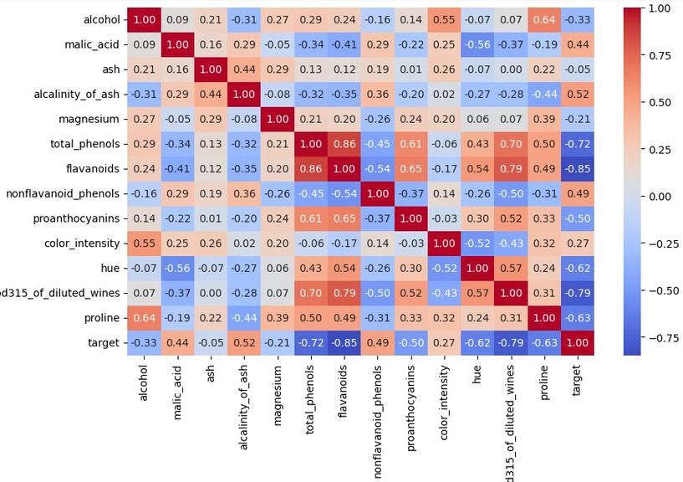
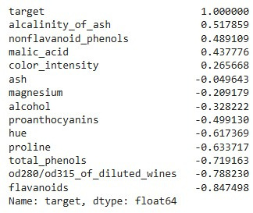
VISUALISASI
Scoring criteria:
Closer to 1 → Strong positive relationship (if feature goes up, target goes up).
Closer to -1 → Strong negative relationship (if feature goes up, target goes down).
Closer to 0 → Weak relationship/no relationship.
Conclusion:
The flavanoids, od280/od315_of_diluted_wines, and total_phenols features are the most target-defining as they have the highest correlation with the target (close to -1).
The higher the value of flavonoids, od280/0d315_of diluted wines, and total_phenols, the smaller the target value (wine class changes).
The ash feature has a small correlation so it has less influence on the target.
DSF 36.0 - Data Science

Slide 11
THANK YOU
DSF 36.0 - Data Science

